Slide 1

Model Selection (and Validation)
Part II
Rayid Ghani and Kit Rodolfa

Slide 2
Short Quiz

Slide 3
Reminders
This week:
Project check-in on Wednesday
Group work on Thursday
Coming up next week:
Due Monday: update assignment (and revisions from last week)
Reading for Tuesday
Coming up the following week:
Midterm Project Progress Presentations (Live or Recorded?)

Slide 4
Plan for the week
What you should be discussing this week within your team
Refining pipeline structure
Features you want to build
What you should be building this week
Pipeline updates based on feedback from Wednesday
Iterating on code for validation splits, model grid, feature sets

Slide 5
Scope
Data
Exploration
Modeling
Get Data
Store Data
Link Data
Rows
Features
Labels
Model Selection
Train-Test Splits
Performance Metrics
Model Interpretation
Entities
temporal
Spatial
…
Models
Dealing with Bias and Fairness
Field Trial Design
Deployment
Monitoring
Goals, Actions, Data, Analysis, Ethics

Slide 6
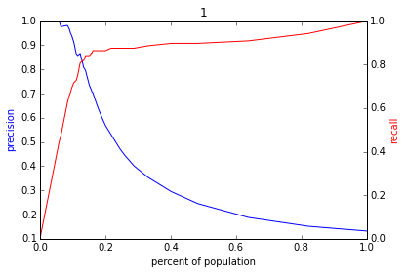
Reminder: The PR-k graph
Score
1 .9 .8 .7 .6 .5 .4 .3. .2 .1
| | | | | | | | | |
Baseline

Slide 7
Any questions from the video lecture?

Slide 8
Reminder: How to solve a prediction problem
Define and Create Rows (unit of prediction)
Define and Create Label (outcome variable)
Define and Create Features (predictors)
Create Training and Validation/Test Sets
Train model(s) on Training Set
Validate model(s) on Validation/Test Set
Select “best” model

Slide 9
Modeling Steps
Training
Features
Training
Learned model
Training Data
Labels/Outcomes
Testing/Validation
Apply Model
Test Data
Features
Predictions
Evaluate
Labels
Metrics

Slide 10
Why do we need to do model selection?
You’ve run a large number of different types of models varying …
You need to understand what types of models are effective under what circumstances, and
You need to decide which one(s) to use in the future

Slide 11
What do we to perform model selection
Deployment scenario
Model selection Methodology
Metric(s) (need to match your policy goals)
Comparison with baselines (to know if you’re effective)

Slide 12
What do we need our selected model to do?
Perform well
What metric?
Compared to what?
Generalize
Over what dimension?

Slide 13
In-sample
Data
Train
Validate

Slide 14
Out-of-Sample
Data
Train
Validate

Slide 15
N-fold Cross-Validation
Data
1
2
3
4
5
Train
Validate

Slide 16
N-fold Cross-Validation
Data
1
2
3
4
5
Train
Validate

Slide 17
N-fold Cross-Validation
Data
1
2
3
4
5
Train
Validate

Slide 18
N-fold Cross-Validation
Data
1
2
3
4
5
Train
Test

Slide 19
N-fold Cross-Validation
Data
1
2
3
4
5
Train
Validate

Slide 20
Temporal Holdouts
Data
2002 2017
Train
Validate
2002 2007 2008
Train
Validate
2002 2008 2009
Train
Validate
2002 2009 2010

Slide 21
Training - Time splits
Train
Validate
2002 2009 2010
Train
We only use this time
to get outcomes
2002 2009

Slide 22
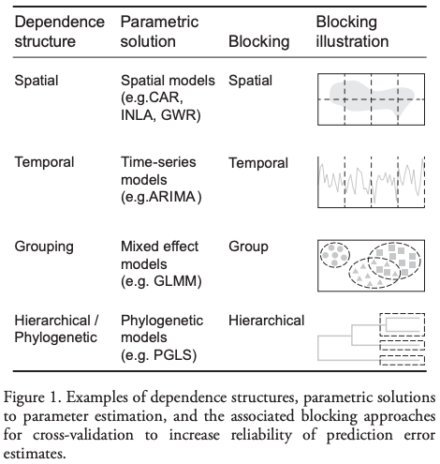
Evaluation - Methodology
In-sample
Out of sample
Multiple Out-of-sample (Hold-out) Splits
Cross Validation
Leave one out (LOO)
K fold
Holdouts Using Structure of Data
Temporal
Spatial, Hierarchical, etc.

Slide 23
The wonderful for loop
For train-test splits (CV or temporal)
For subsets of Feature Sets (Demographic only, Behavior only, Temporal only, etc.)
For Classifiers (RFC, SVM, DT, NN, Logit, GB, Boosting)
For parameters (cross products of different parameters)
Fit
Predict
Evaluate

Slide 24
Results
Classifier | Param 1 | Param 2 | Validation Split | Feature Subsets used | Accuracy | Prec @ 1% | AUC

Slide 25
Analyzing the results
Which approaches work best?
Which classifiers?
Which parameters?
Over which metrics?
Value of different features/feature sets?
Variance in performance over time?
Highest average?
Lowest variance?
Getting better over time?

Slide 26
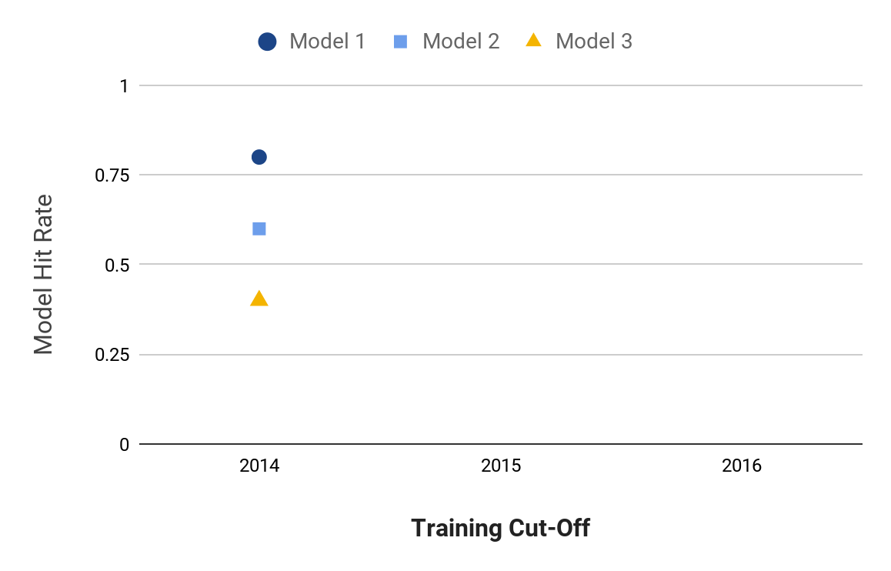
Model Selection
Notes:
Jane

Slide 27
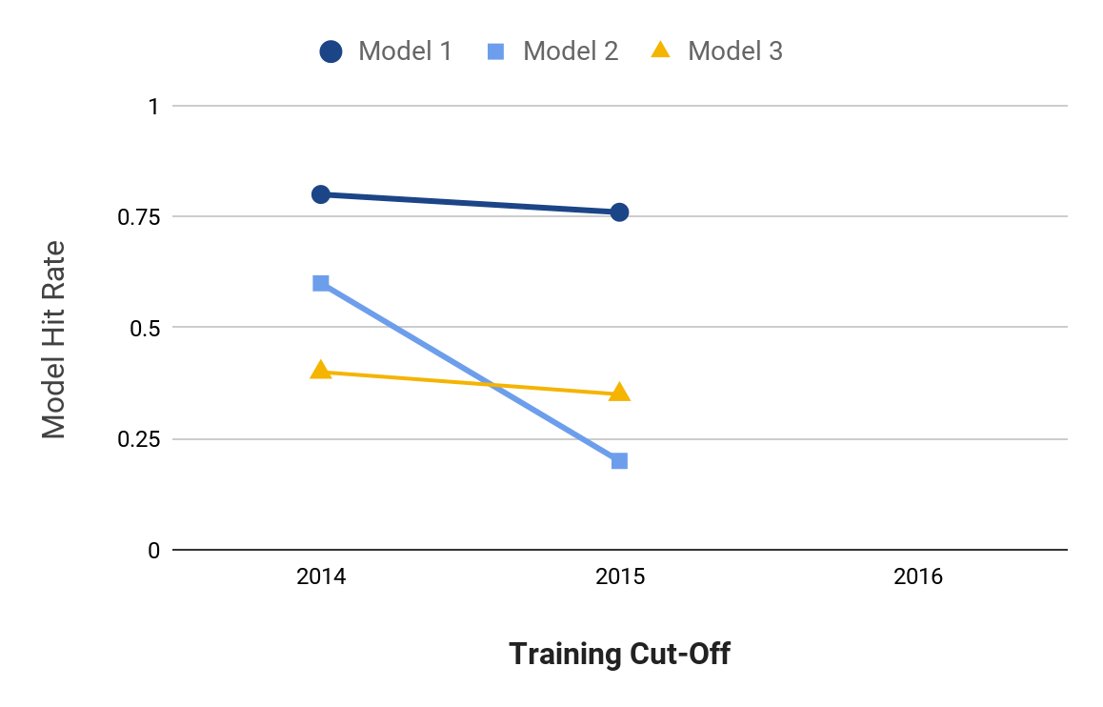
Model Selection
Notes:
Jane

Slide 28
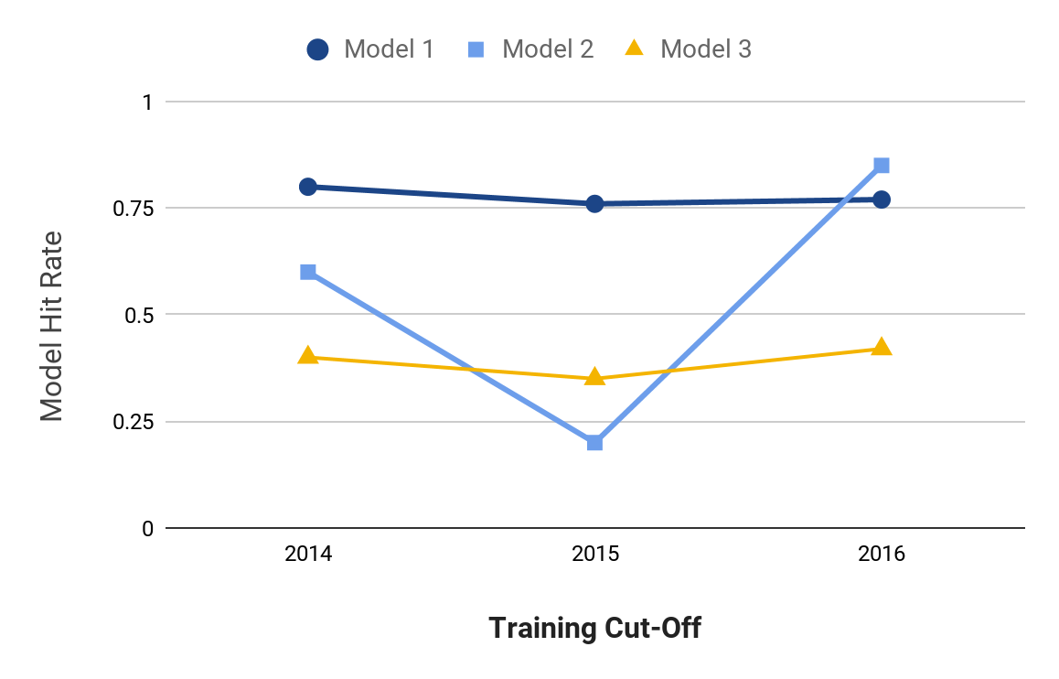
Model Selection
Notes:
Jane

Slide 29
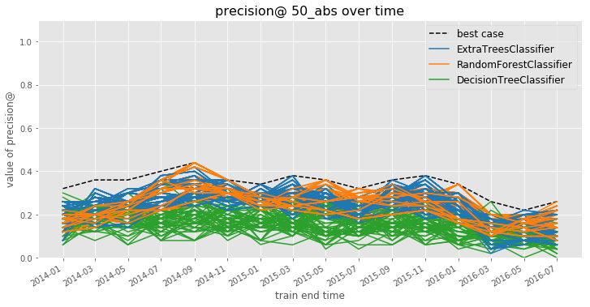
Model Selection
Notes:
Jane

Slide 30
Model Selection
How can you narrow hundreds or thousands of model specifications down to a handful of the best-performing ones?
How do you balance performance and stability?
mean performance?
balancing mean and variance?
recency-weighted mean?
What is the “regret” in subsequent time periods from using different strategies for choosing a model to deploy?
Notes:
Jane

Slide 31
Model Selection
Comparing Model Selection Strategies:
Use test set performances up to a given point in time to do model selection using each strategy
On the subsequent validation set, calculate a regret for the model selection strategy as the difference between the performance of the model specification that strategy chooses and the best-performing model specification on this new validation set
Notes:
Jane

Slide 32
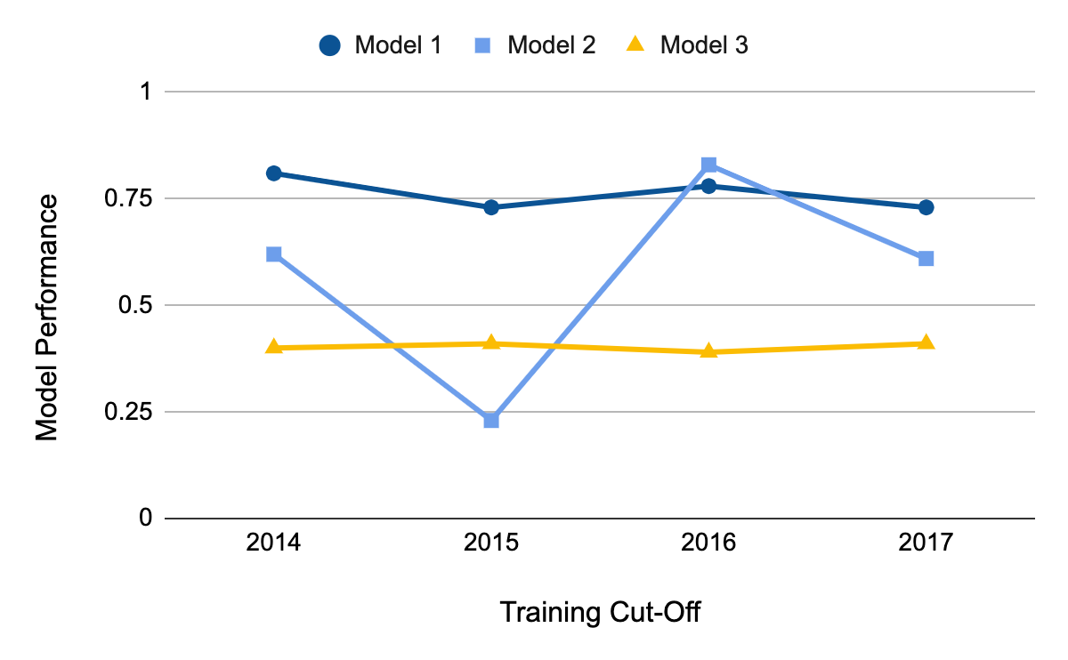
Model Selection
Apply model selection strategies to validation set performance through 2016
Notes:
Jane

Slide 33
Model Selection
Apply model selection strategies to test set performance through 2016
Calculate regret based on 2017 validation set performance
Notes:
Jane

Slide 34
Model Selection
Best Recent Perf:
Model 2
Best Average Perf:
Model 1
Lowest Variance: Model 3
Notes:
Jane

Slide 35
Model Selection
Best Model in 2017:
Model 1
Perf = 0.73
Notes:
Jane

Slide 36
Model Selection
Best Recent Perf:
Model 2
Regret:
0.73 – 0.61 = 0.12
}
Notes:
Jane

Slide 37
Model Selection
Best Average Perf:
Model 1
Regret:
0.73 – 0.73 = 0.00
}
Notes:
Jane

Slide 38
Model Selection
Lowest Variance: Model 3
Regret:
0.73 – 0.41 = 0.32
}
Notes:
Jane

Slide 39
Model Selection
Strategy | Best Model Through 2016 | Regret in 2017
Best Recent Perf. | Model 2 | 0.12
Best Average Perf. | Model 1 | 0.00
Lowest Variance | Model 3 | 0.32
Notes:
Jane

Slide 40
Model Selection
Strategy | Best Model Through 2016 | Regret in 2017
Best Recent Perf. | Model 2 | 0.12
Best Average Perf. | Model 1 | 0.00
Lowest Variance | Model 3 | 0.32
Notes:
Jane

Slide 41
Model Selection
Notes:
Jane

Slide 42
Model Selection
Notes:
Jane

Slide 43
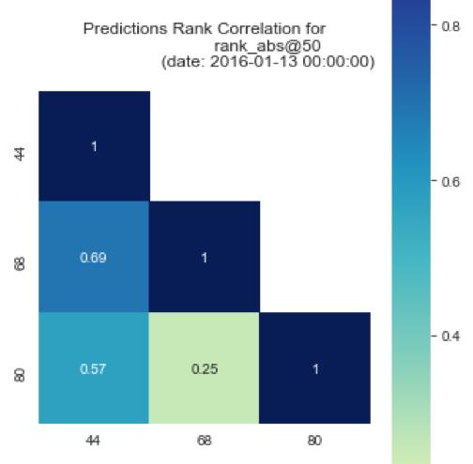
Model Selection
May not be obvious which strategy / model specification is “best”
Among good candidates, may be instructive to ask how similar or different the lists each strategy would produce are
May ultimately want to deploy (or at least test) a strategy that combines across several specifications
Notes:
Jane

Slide 44
Some Open Research Questions
What are the conditions under which temporal validation out-performs traditional cross-validation? By how much?
Likewise, what can we learn about how well certain strategies perform in terms of regret under different real-world conditions?
Many problems in policy settings involve resource constraints that require optimization at the top of the list, but few methods optimize for this directly.
e.g., Transductive Top k

Slide 45
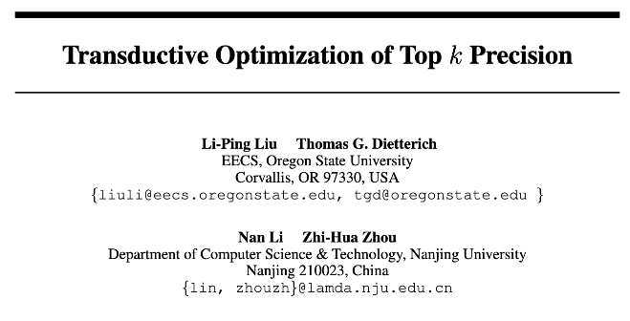
Some Open Research Questions

Slide 46
Some Open Research Questions
The SVM loss function will find the “best” separating hyperplane overall, but perhaps we could draw a better hyperplane to separate just k positive examples?
Transductive method: needs to be aware of the test set without labels to select just k test examples.
Modified gradient descent procedure to project gradient direction for L2-regularized SVM loss onto a “feasible solution cone” such that no more than k test examples will be predicted positive after the step.

Slide 47
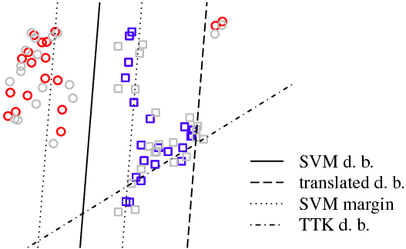
Some Open Research Questions

Slide 48
Some Open Research Questions
Paper shows improvements on synthetic examples and some “standard” datasets, but still more to investigate:
Can be slow to converge on larger datasets
“At most” k examples can yield many fewer than the desired k, particularly for rare events (why doesn’t the algorithm target exactly k?)
Although creating a “top k” boundary, still penalizes false positives and false negatives equally during optimization
Can we do better at the top, even if we don’t have access to the test list?

Slide 49
Discussion Question
What would be some potential strategies for integrating considerations around fairness in the process of model evaluation and selection?

Slide 50
Reminders
This week:
Project check-in on Wednesday
Group work on Thursday
Coming up next week:
Due Monday: update assignment (and revisions from last week)
Reading for Tuesday
Coming up the following week:
Midterm Project Progress Presentations

